Slide 1
VOLTTRON Hackathon
September 17, 2018

Slide 2
Plan for the Day
Participant introductions
VOLTTRON and the Hackathon
Activity #1: Use notebooks to install/run VOLTTRON agents
- Lunch Break -
Discuss Activity #1
Inserting python code into VOLTTRON agents
Activity #2: Energy management in VOLTTRON
Participant demonstrations
General discussion
Notes:
Participant introductions:
. Any VOLTTRON experience? Any learning goals for today?
. Alert people that we plan to preserve the code they write in the notebook to help us assess the Hackathon’s effectiveness. If that’ll be a problem, please let us know.
Who are we:
. SLAC has helped to advance the use of VOLTTRON through software contributions to the platform, reference implementations, and trainings like this one.
. ChargePoint Energy Solutions (formerly Kisensum), and Rob and James in particular, have been frequent contributors to the platform.

Slide 3
What is VOLTTRON?
Awesome and powerful, true, but no, not that Voltron!
(Our VOLTTRON has two T’s.)
VOLTTRON on GitHub: https://github.com/VOLTTRON/volttron
VOLTTRON ReadTheDocs: https://volttron.readthedocs.io/en/latest/
Notes:
The VOLTTRON platform is unrelated to the Dreamworks superhero, which predates it by many years (Defender of the Universe premiered in 1984).

Slide 4
WHY VOLTTRON?
Grid modernization is an essential element of national (and international) energy strategy
VOLTTRON uses an open-source software platform to facilitate communication, management and device control within microgrids, e.g., for Distributed Energy Resources (DERs)
It also facilitates communication between energy suppliers and consumers, for instance enabling Demand Response (DR)
Created at Pacific Northwest National Laboratory (PNNL) with sustained support from the Department of Energy
Notes:
Relate this to SB100 and Governor Brown’s executive order aiming for California carbon neutrality by mid-century.
During the GMI Peer Review in Washington DC two weeks ago, many researchers shared results from projects using VOLTTRON.

Slide 5
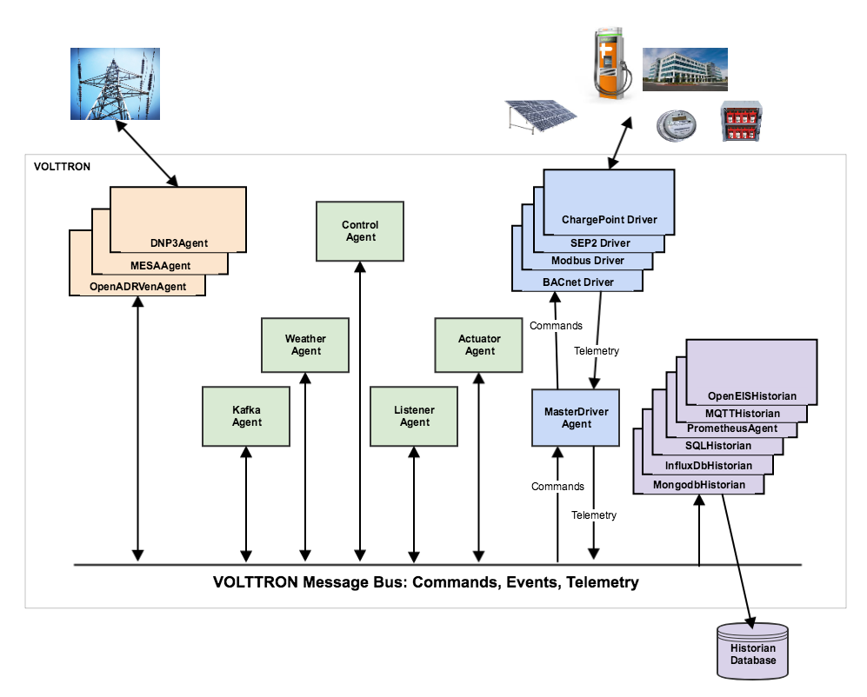
OK, What is VOLTTRON?
Open source platform
Secure message bus
Device drivers
Historians
Protocol adapters
Other agents
Federated instances (not shown)
Notes:
Talk about each type of agent, and how they might be used in tandem.

Slide 6
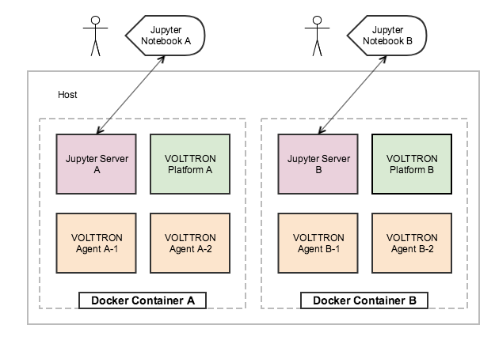
The Hackathon
Today we’ll use VOLTTRON with:
Jupyter notebooks
Web-based notebooks execute code (Python) on a remote host (AWS)
Docker containers
Each participant has a separate process/memory/disk space on the remote host
Notes:
Describe how Jupyter works.
Describe how Docker works.

Slide 7
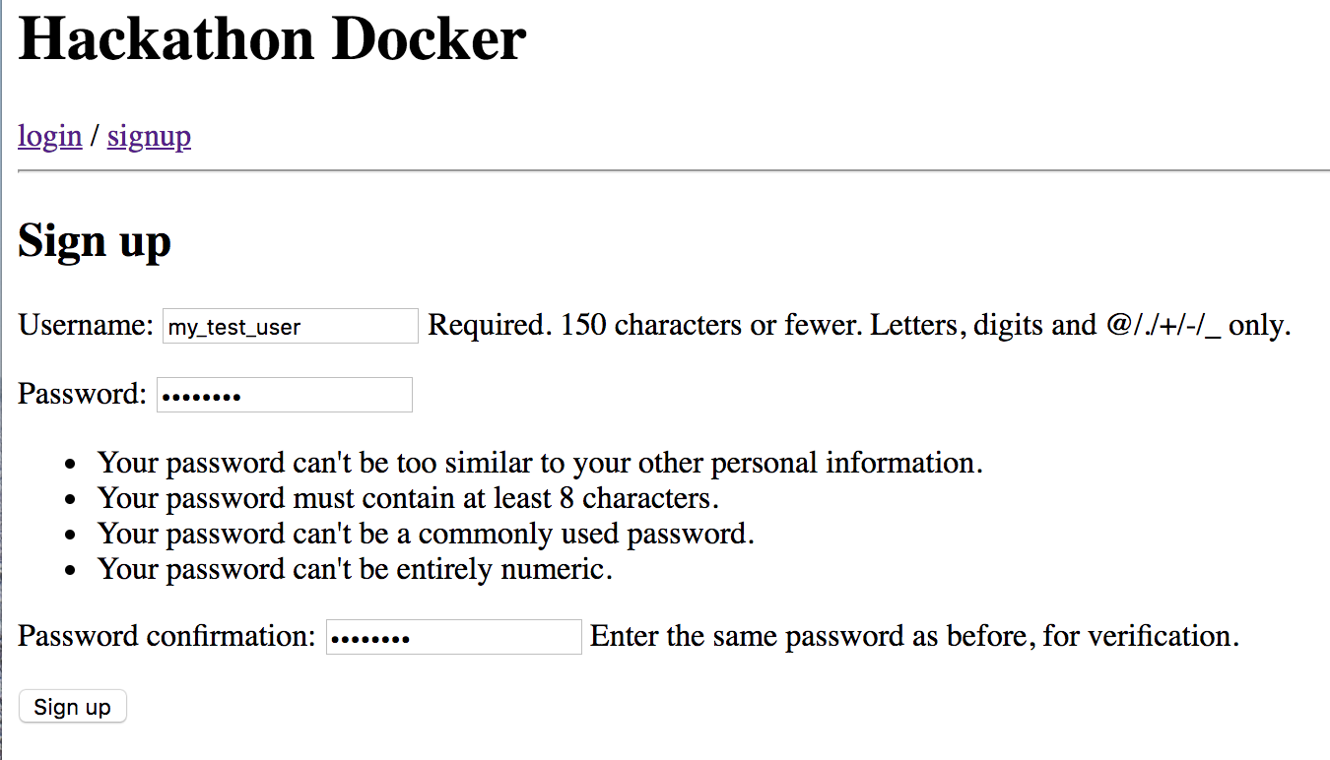
Getting Started
Start self-enrollment by navigating in a browser to:
http://hackathon2.ki-evi.com:8000/volttron
Create a username and password for yourself and click Sign up.
Notes:
Starting here, this is a quick run-through of what participants will do themselves at the start of Activity 1.

Slide 8
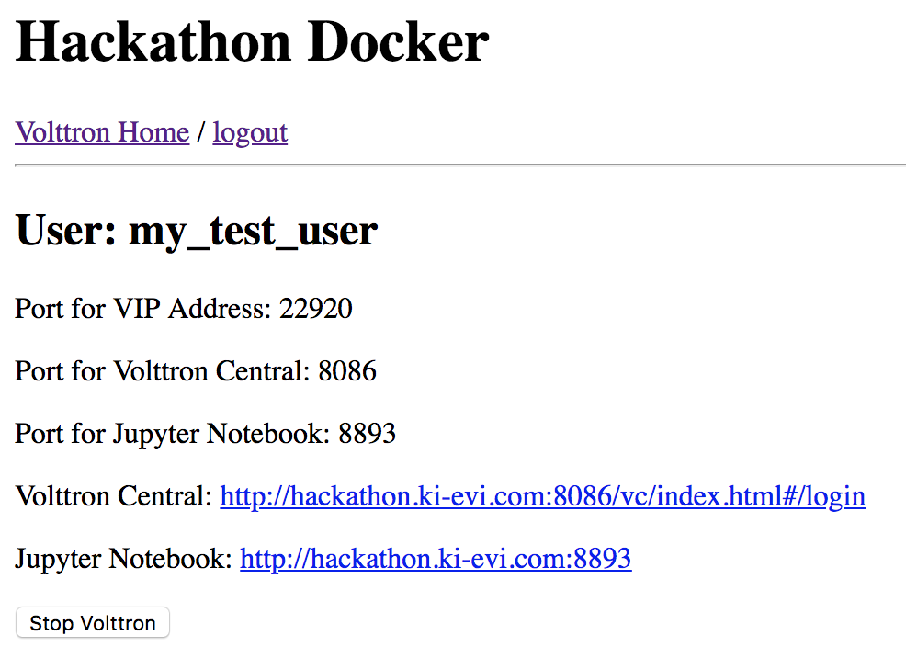
Getting Started
Your account gets assigned a Docker container and a set of host ports.
The Docker container is started, and its VOLTTRON instance and Jupyter server are started.
To start using your notebook, click the Jupyter Notebook hyperlink.
Notes:
The Volttron Central hyperlink will become useful later, when we’re ready to report on what the agents are doing.

Slide 9
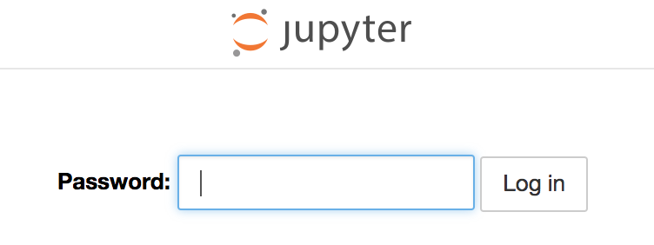
Getting Started
When prompted for a Jupyter password, enter “volttron”
Notes:
Today, in the interests of time, we’ll mostly ignore VOLTTRON’s security/authorization framework.

Slide 10
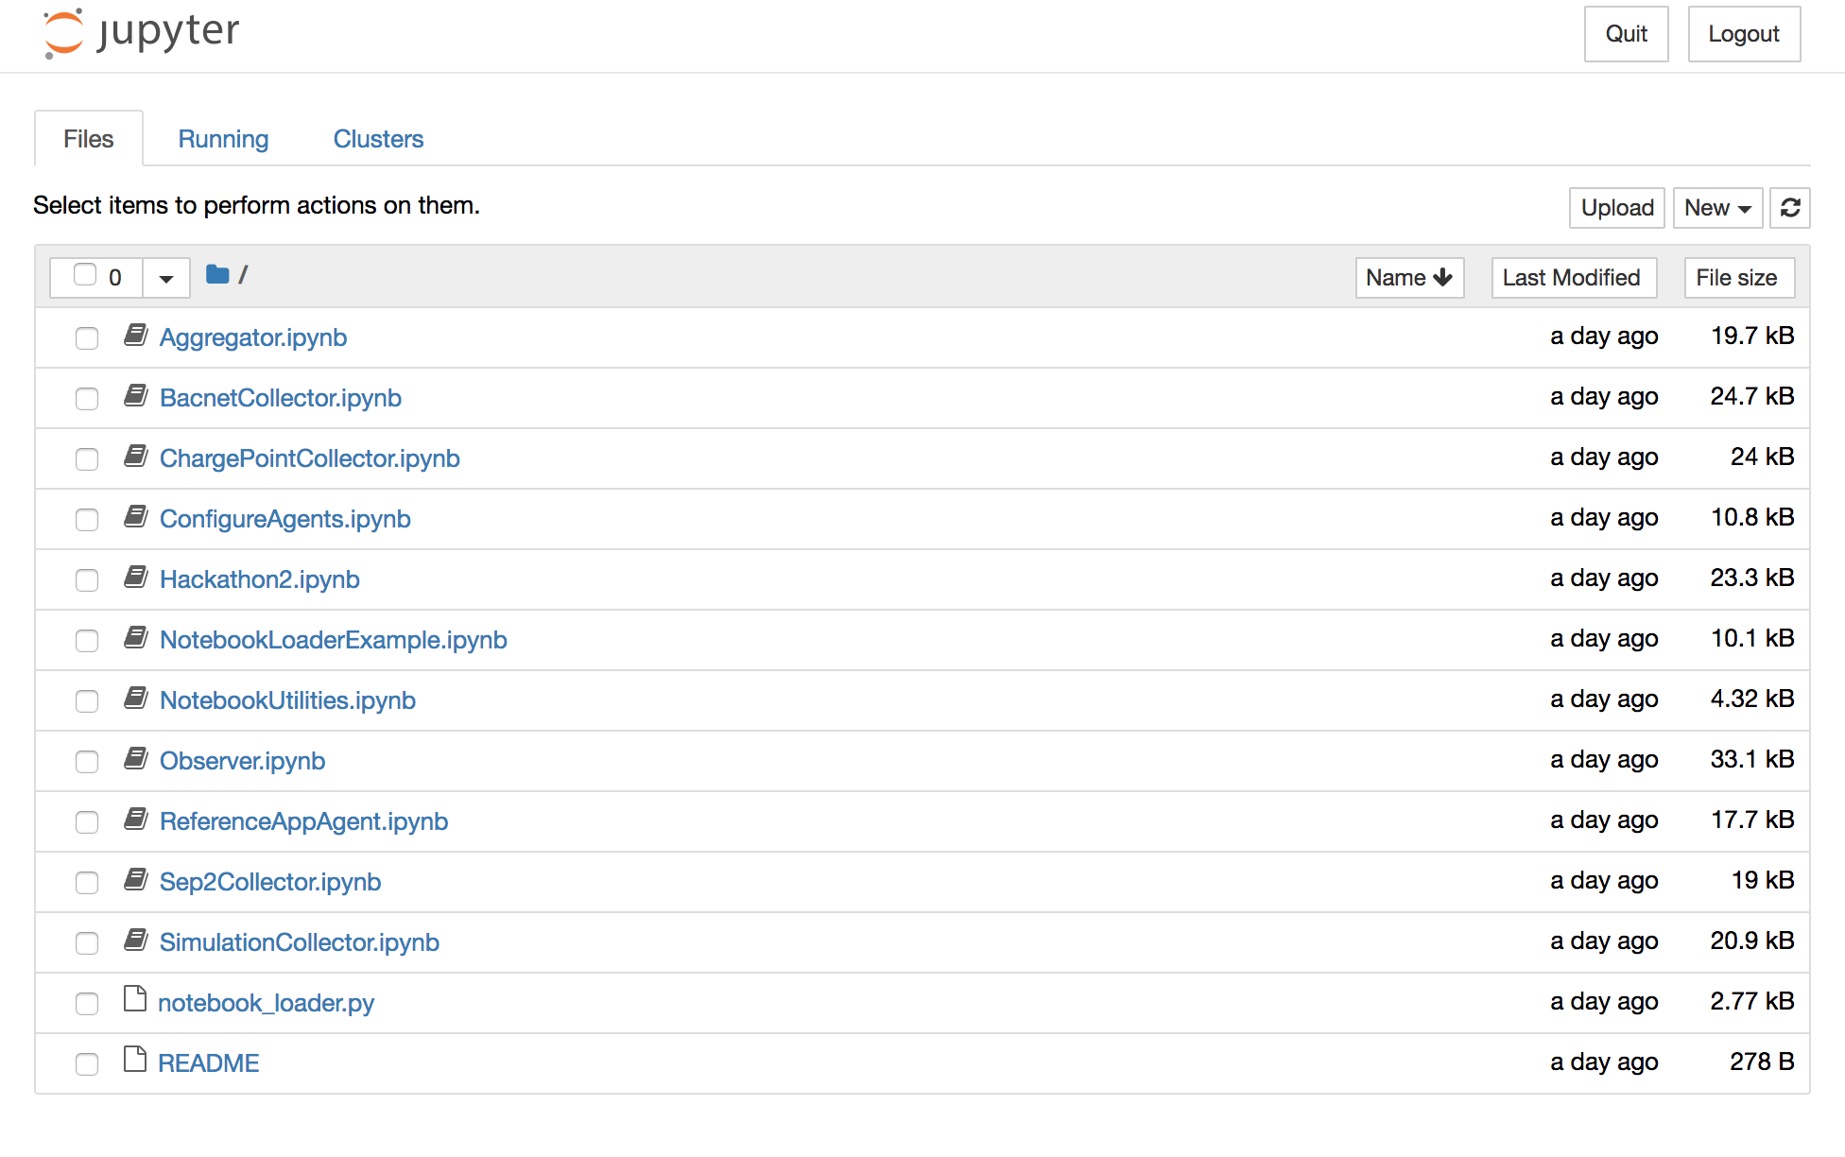
Getting Started
In the jupyter directory listing, select the notebook named Hackathon2
Notes:
Discuss the other notebooks.
Some are holdovers from last year’s Hackathon.
Others (NotebookUtilities, ConfigureAgents) contain tools and utilities.
Discuss loading one notebook from another (we’ll get into that more in a little while).

Slide 11
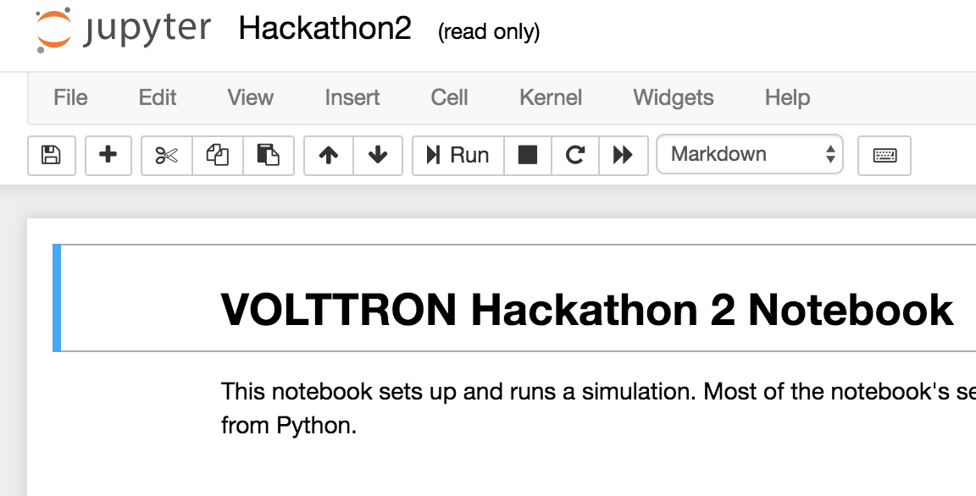
Getting Started
In a notebook, click “Run” to execute the Python code in the current cell.
The cursor will advance to the next cell.
Notes:
If all goes as it should, you can spin up the VOLTTRON agents and view simulation results simply by clicking “Run” repeatedly.
But don’t do that! For a better understanding, read and understand the documentation and Python code in each of the notebook’s cells.
Also, have a care: if you “click ahead”, executing cell N+1 before cell N has finished, the notebook can become confused.
You can always start over from the beginning by restarting the kernel.

Slide 12
Activity #1: Install and Run VOLTTRON Agents
OK, it’s your turn. In this first activity, execute the code in your notebook up through the cell named “Graph Values for a Single Topic”, reading the descriptions.
Observe the device metrics that were captured (how were they captured?). What is the shape of the curve, and what does it represent?
Notes:
This activity lasts until the lunch break.
Its purpose is to teach people how to use the notebooks so they’ll be ready for Activity #2.

Slide 13
Activity #1: Discussion
Problems?
Comments?
Notes:
(after lunch)
(keep this quick, so that there’s plenty of time for the afternoon’s programming challenges)

Slide 14
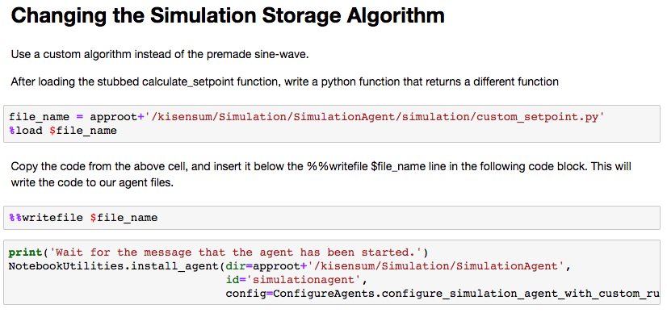
Inserting Python Code Into Agents

Slide 15
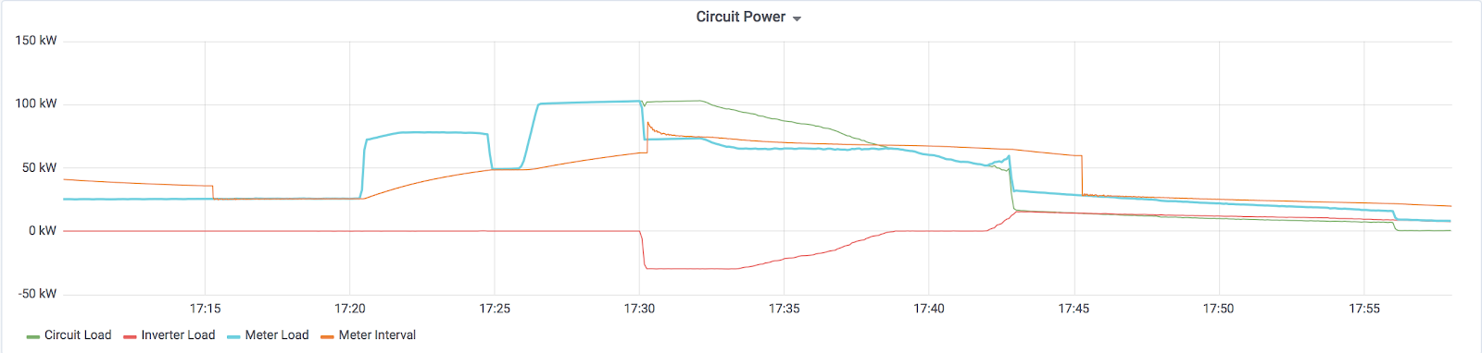
ACTIVITY #2, Part 1 Peak Averaging
A common calculation for peak consumption is using fifteen minute power averages rather than instantaneous peak load. Let’s try to control our microgrid to match this definition of peak consumption. This will allow us to be less reactive to changes in microgrid consumption and conserve our battery for true periods of high demand.
Your goal is to keep microgrid circuit power below a threshold, calculated as average power during a time increment (we’ll use a default of 15 minutes).

Slide 16
ACTIVITY #2, Part 1 Peak Averaging
def calc_average_power(power_now, time_now, time_previous, avg_power_previous, interval_length):
Calculate the current average microgrid power for the given interval. Python help: when subtracting timestamps, you can use the total_seconds() method to return a float representation of
the timedelta. Ex: (ts1-ts2).total_seconds()
:param power_now: Current microgrid power reading
:param time_now: Current simulation timestamp
:param time_previous: Most recent previous power reading timestamp
:param avg_power_previous: Running average of power readings for the interval
:param interval_length: Length of interval (in minutes) :return: avg_power_now: newly calculated average interval power
def calc_setpoint(power_now, setpoint_previous, time_now, avg_power_now, interval_length, target_power, max_charge_kw, max_discharge_kw):
Calculate a control setpoint that will keep the microgrid power as close to the target_power as possible. Keep
in mind that a control_setpoint cannot dispatch greater than max_charge_kw, nor discharge less than negative (-) max_discharge_kw
:param power_now: Current microgrid power reading
:param setpoint_previous: The previous setpoint sent to the inverter/battery
:param time_now: Current simulation timestamp
:param avg_power_now: Current average power reading for the interval
:param interval_length: Length of interval (in minutes)
:param target_power: Control threshold for the microgrid
:param max_charge_kw: Max allowable charge for the battery
:param max_discharge_kw: Max allowable discharge for the battery
:return: setpoint: Control setpoint to send to the inverter/battery

Slide 17
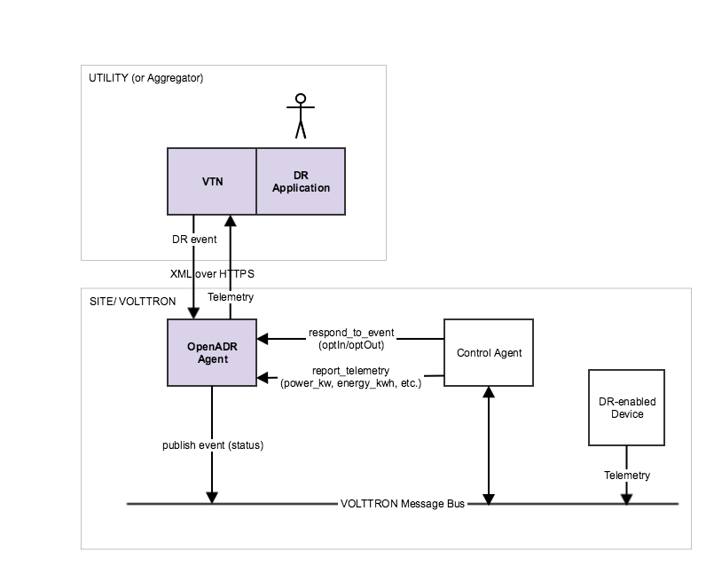
Activity #2, Part 2 Changing target threshold
In the last exercise, we used a static threshold for our control point. What happens if we want to change this threshold? We’ll look at two different ways to change our control point.
Dynamic Peak Setting - A common tariff model is based on a peak power for the month. Rather than a static threshold, let’s set our control point to the largest peak to date. Our goal is simply to avoid setting a new peak. Bonus Points: reset the peak every month when a utility bill might roll over.
Receive and Respond to Utility Signals - We can also manage microgrid circuit power in response to utility signals. OpenADR is a Demand Response protocol that allows utilities to signal DR events and participants to opt in. Using OpenADRVenAgent, we can receive OpenADR events and lower our power threshold during captured DR events.

Slide 18
Activity #2, Part 2 Changing target threshold
def calc_target_power(sim_data, time_now, time_previous, avg_power_previous, default_meter_target, reduced_meter_target, interval_length):
"""For the initial timeframe, the target will be a default value of 470. If we are controlling using VTN Events,
we need to check if we are in an event and reduce the meter_target if we are.
:param sim_data: Dictionary of in memory information stored by the simulation agent
:param time_now: Current simulation time
:param time_previous: Most recent previous power reading timestamp
:param avg_power_previous: Previous Avg Power calculation (needed as proxy for previous interval power when interval rolls over
:param default_meter_target: Meter target when not under DR
:param reduced_meter_target: Meter target when under DR event
:param interval_length
:return: Target setpoint for the meter
"""
from datetime import datetime
if sim_data.get('start_event', None):
event_start_time = datetime.strptime(sim_data['start_event'], "%Y-%m-%d %H:%M:%S+00:00")
event_end_time = datetime.strptime(sim_data['end_event'], "%Y-%m-%d %H:%M:%S+00:00")
return default_meter_target

Slide 19
Activity #2: Programming challenge
OK, it’s your turn again!
Feel free to ask questions as you implement your energy management algorithms.
We’ll review each others’ work at the conclusion of the activity.

Slide 20
Participant Demonstrations
Show us what you’ve created!

Slide 21
Discussion
Comments on VOLTTRON?
Comments on the Hackathon?
rob.calvert@chargepoint.com
james.sheridan@chargepoint.com
Notes:
Now that you’ve used VOLTTRON, does it seem like a useful tool?
Which parts of the Hackathon were confusing? Which parts were useful to you?
These materials are available in Github’s VOLTTRON / volttron-training repository.

